Slide 1




Levenshtein distance/ edit distance. By Srinivas Makkena
Minimum operations to transform one string into another

Slide 2

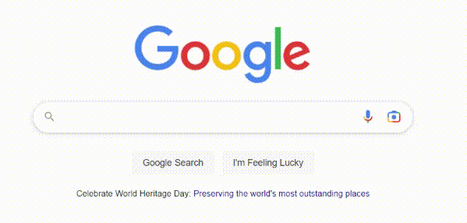
?
How do search engines provide suggestions for misspelled queries?
How do spell correction in different applications work?

Slide 3
Calculate Minimum number of operations required to convert a given string into another string? Allowed operations: Insertion, Deletion, Replacing
E.g.:
String 1 – Hall
String 2 – Hello
H
Changes did : 0
Same char H
Hello
Changes did : 2
Inserted o
Hell
Changes did : 1
Same char l
He
Changes did : 1
Replaced a with e
Hel
Changes did : 1
Same Char l
Edit Distance = No of minimum operations = 2

Slide 4

The Levenshtein distance between two strings (of length and respectively) is given by where

Slide 5
Distance Matrix calculation
 | “ ” | H | A | L | L
“ ” | 0 | 1 | 2 | 3 | 4
H | 1 | 0 | 1 | 2 | 3
E | 2 | 1 | 1 | 2 | 3
L | 3 | 2 | 2 | 1 | 2
L | 4 | 3 | 3 | 1 | 1
O | 5 | 4 | 4 | 2 | 2
 | “ ” | H | A | L | L
“ ” | 0 | 1 | 2 | 3 | 4
H | 1 | 0 | 1 | 2 | 3
E | 2 | 1 | 1 | 2
L | 3
L | 4
O | 5
 | “ ” | H | A | L | L
“ ” | 0 | 1 | 2 | 3 | 4
H | 1 | 0 | 1 | 2 | 3
E | 2 | 1 | 1
L | 3
L | 4
O | 5
 | “ ” | H | A | L | L
“ ” | 0 | 1 | 2 | 3 | 4
H | 1 | 0 | 1 | 2 | 3
E | 2 | 1 | 1 | 2 | 3
L | 3
L | 4
O | 5
 | “ ” | H | A | L | L
“ ” | 0 | 1 | 2 | 3 | 4
H | 1 | 0 | 1 | 2 | 3
E | 2 | 1 | 1 | 2 | 3
L | 3 | 2
L | 4
O | 5
 | “ ” | H | A | L | L
“ ” | 0 | 1 | 2 | 3 | 4
H | 1 | 0 | 1
E | 2
L | 3
L | 4
O | 5
 | “ ” | H | A | L | L
“ ” | 0 | 1 | 2 | 3 | 4
H | 1 | 0 | 1 | 2
E | 2
L | 3
L | 4
O | 5
 | “ ” | H | A | L | L
“ ” | 0 | 1 | 2 | 3 | 4
H | 1 | 0 | 1 | 2 | 3
E | 2 | 1
L | 3
L | 4
O | 5
 | “ ” | H | A | L | L
“ ” | 0 | 1 | 2 | 3 | 4
H | 1 | 0 | 1 | 2 | 3
E | 2
L | 3
L | 4
O | 5
 | “ ” | H | A | L | L
“ ” | 0 | 1 | 2 | 3 | 4
H | 1 | 0
E | 2
L | 3
L | 4
O | 5
 | “ ” | H | A | L | L
“ ” | 0 | 1 | 2 | 3 | 4
H | 1
E | 2
L | 3
L | 4
O | 5
If Character matches on both words
copy diagonal value
Else
insert minimum of the previous values (i-1 j-1 , i-1 j, I j-1) by adding 1 to it

Slide 6
Pseudo code
function LevenshteinDistance(string1, string2):
lenOfStr1 = length(string1) → length of string 1
lenOfStr2 = length(string2) → length of string 2
distance = array(lenOfStr1 + 1, lenOfStr12 + 1) → creating multi-dimensional array
for i from 0 to lenOfStr1 : → looping on first column and adding initial values
distance[i, 0] = I
for j from 0 to lenOfStr12: → looping on first row and adding initial values
distance[0, j] = j
for i from 1 to lenOfStr1:
for j from 1 to lenOfStr2:
if string1[i] == string2[j]: → copying prev value to distance array if same char
distance[i, j] = distance[i-1, j-1]
else: → else copying min of prev ([i-1][j-1], [i-1][j], [i][j-1]) values +1
distance[i, j] = min(distance[i-1, j-1], distance[i-1, j], distance[i, j-1]) + 1
return distance[lenOfStr1, lenOfStr2]
Consider A as distance Array
A[i-1][j-1] | A[i-1][j]
A[i][j-1] | X=A[i][j]

Slide 7


Spelling correction and suggestion: The algorithm can be used to suggest correct spellings for misspelled words. Text-to-speech alignment: The algorithm can align text with corresponding audio to create closed captions or subtitles. DNA analysis: The algorithm can be used to compare DNA sequences to identify similarities and differences between them. Plagiarism detection: The algorithm can detect instances of plagiarism by comparing the similarity between texts.
Applications:

Slide 8
Thank you!
Do you have any questions?

